Slide 1
Modified DOBSS proofs

Slide 2
Modified DOBSS proof
Let us look at the constraints one by one discuss how to eliminate the follower strategies to find how Modified DOBSS reaches an optimal solution. (the solver doesn’t iteratively eliminate the strategies, rather it solves the problem like a normal MILP problem, iterative elimination is for our understanding).
Follower
payoff
Breaking ties against the follower
Solution of DOBSS
Highest possible follower payoff
Highest possible leader payoff
Leader
payoff

Slide 3
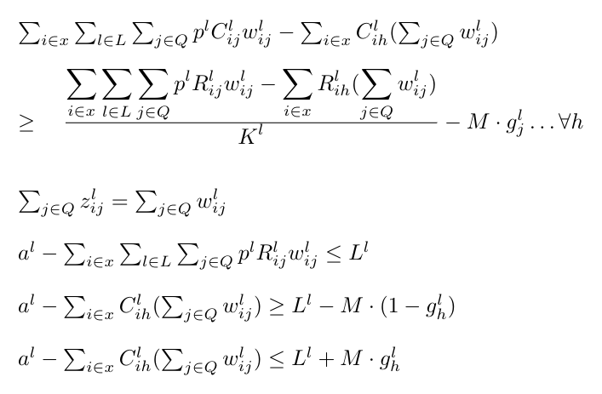
Constraint 1
Follower Payoff for current strategy
Follower’s maximum payoff
Stop loss
The selected strategy should be within loss limit.
So, this equation is added in order to remove all strategies from search space which do not lie within a distance of L^{l} from the best payoff yielding strategy

Slide 4
Constraint 2
Follower Payoff for a selected strategy
Follower’s maximum payoff
Stop loss
Truth value M
These constraints are added to find if a given pure strategy of the follower is lying within a distance of L^{l} from the best payoff yielding strategy. We can consider only those strategies which lie within the range are used to further pick the follower strategy. (the given equations are vectorized notations, i.e. they hold ∀ h)

Slide 5
After this, some of the strategies are eliminated as follows
Follower
payoff
Breaking ties against the follower
Solution of DOBSS
a^{l}
Only those strategies which are at a distance l^{l} are allowed in solution
a^{l}-l^{l}
Leader
payoff

Slide 6
Constraint 3
Payoff for some given leader payoff
Payoff for some given follower payoff
Leader Payoff for current strategy
Follower Payoff for current strategy
K factor - hyperparameter 2
Truth value M
Difference - payoff sacrificed
From the paper, we know the parameter K works as follows :-
A strategy is desirable if no other strategy exists, which is at a distance of u within maximum permissible loss-L, to give the leader a loss of at least K*u.
In the above constraint, If a strategy s’ lies within the loss range (reflected by M in the above equation), and ∀ s’ the current strategy is compared to that s’ and one which satisfies the desirability property is picked.

Slide 7
Why should a desirable strategy always exist
Upon careful observation, one can figure out that the constraints on rearrangement gives us.
We are finding a strategy of the follower which maximises :-
Follower payoff - Leader payoff/K
while not completely compromising on follower payoff, as only those strategies which are within the stop loss limit are included in the search space

Slide 8
After this, all strategies but one are eliminated as follows
Find maximum along this line
Follower
payoff
a^{l}
a^{l}-l^{l}
Leader
payoff
Finally the optimal strategy is chosen as follows (the one with star)

Slide 9
About the optima
The optimal strategy will be the one which maximises
Follower payoff - Leader payoff/K
Favourable conditions for optima are
Higher follower payoff
Lower leader payoff
Considering that l^{l} is positive, we will always have at least one strategy (at least the DOBSS solution) present in the feasible set. So, there will always be a solution for the given problem.

Slide 10
About the optima
Also, there is no solution for the above problem with a higher leader payoff compared to DOBSS solution because,...
DOBSS solution - lp₁, fp₁
Solution with better leader payoff for the above problem - lp₂, fp₂
(lp/fp - leader/follower payoff)
This means,
fp₁-lp₁/k < fp₂-lp₂/k
We are searching for …
lp₁ < lp₂
Which implies
fp₁< fp₂
But this is not possible as we have already selected the maximum possible follower payoff when considering the solution for DOBSS. Hence, the leader payoff will be modest (less than or equal to) the payoff estimated by Modified DOBSS.

